Slide 1

Discrete Math Chapter 7
Graphs Algorithms

Slide 2
Chapter 7 Overview
7-1 Directed Graphs
7-2 Euler Path and Hamilton Cycle
7-3 Shortest Path
7-4 Traversal Algorithms

Slide 3
Notes of Chapter 7
The concept of chapter 6 and 7 are connected. Make sure you don’t skip chapter 6 before learning chapter 7.
Even though we will talk about algorithms of graph in this chapter, we won’t discuss all of them. Instead, we will learn more in algorithm and data structure class, as they require more programming skills.

Slide 4

7-1 Directed Graphs

Slide 5
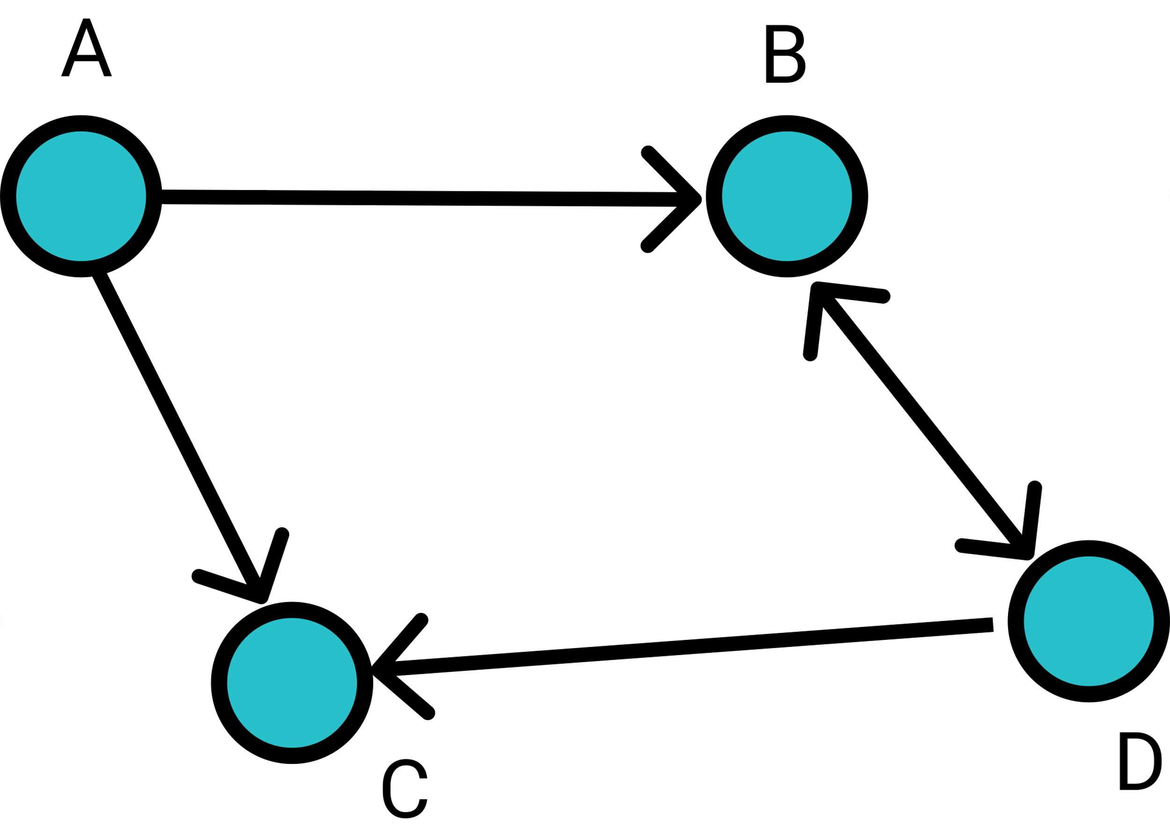
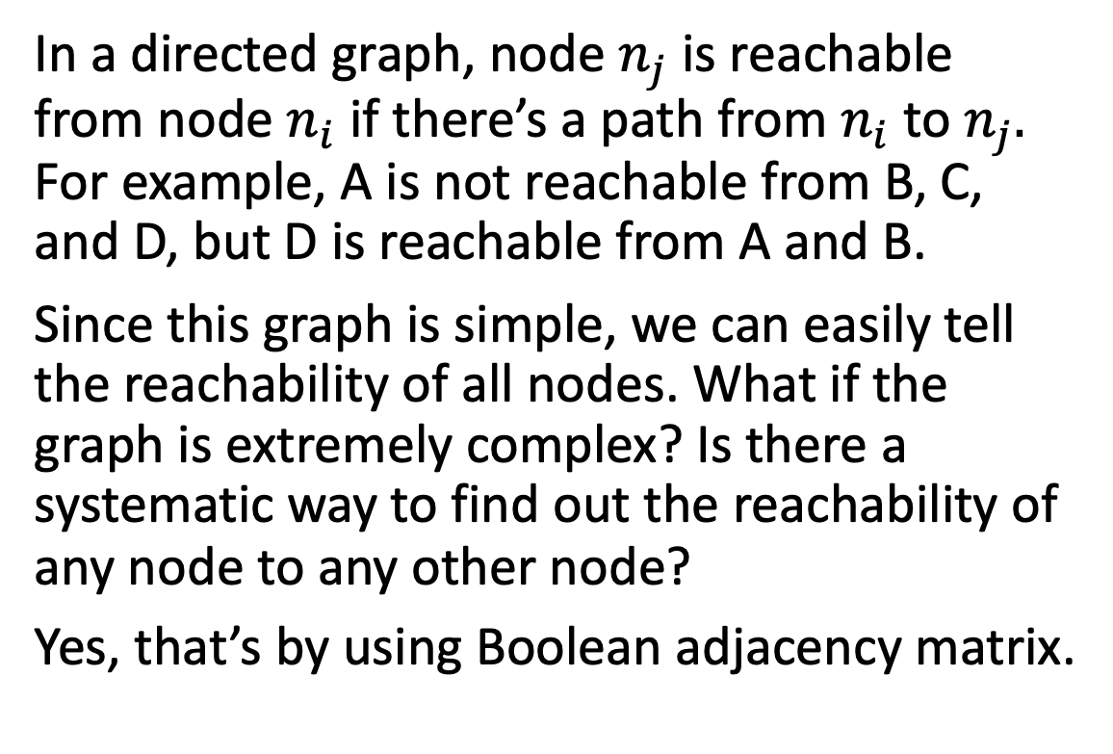
Reachability
In a directed graph, node $n_{j}$ is reachable from node $n_{i}$ if there’s a path from $n_{i}$ to $n_{j}.$ For example, A is not reachable from B, C, and D, but D is reachable from A and B.
Since this graph is simple, we can easily tell the reachability of all nodes. What if the graph is extremely complex? Is there a systematic way to find out the reachability of any node to any other node?
Yes, that’s by using Boolean adjacency matrix.

Slide 6
Boolean Adjacency Matrix
In chapter 6, we learned about adjacency matrix of a graph. Now, let’s view all values in the adjacency matrix as a boolean value. Then, we know that:
0 means false
1 means true
0 + 0 = 0 (false or false is false), 0 + 1 = 1 (false or true is true), 1 + 1 = 1 (true or true is true)
0 x 0 = 0 (false and false is false), 0 x 1 = 0 (false and true is false), 1 x 1 = 1 (true and true is true)

Slide 7
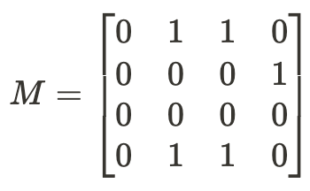
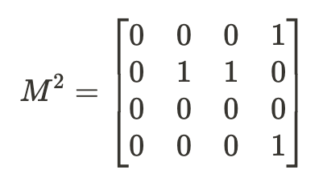
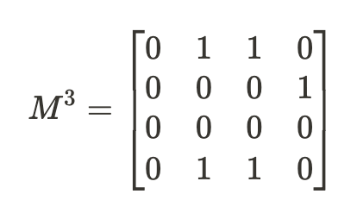
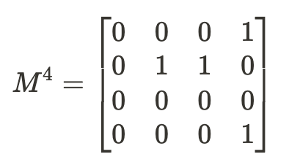
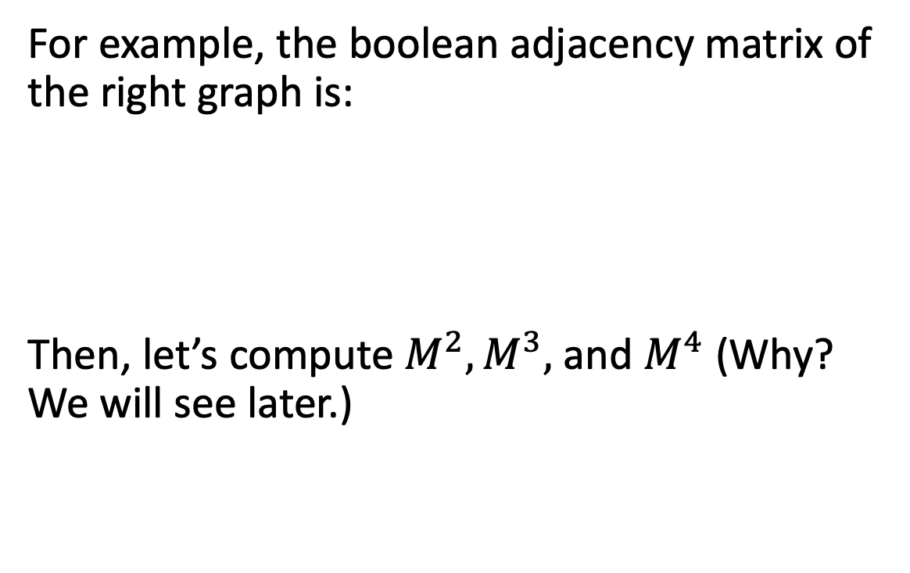
Boolean Adjacency Matrix
For example, the boolean adjacency matrix of the right graph is:
Then, let’s compute $M^{2}, M^{3},$ and $M^{4}$ (Why? We will see later.)

Slide 8
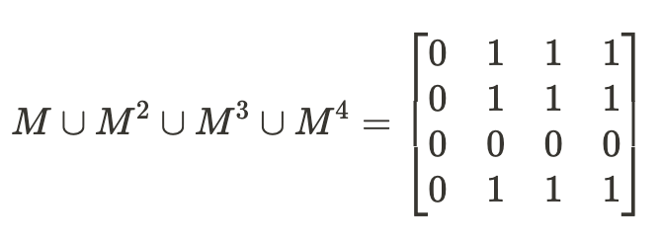
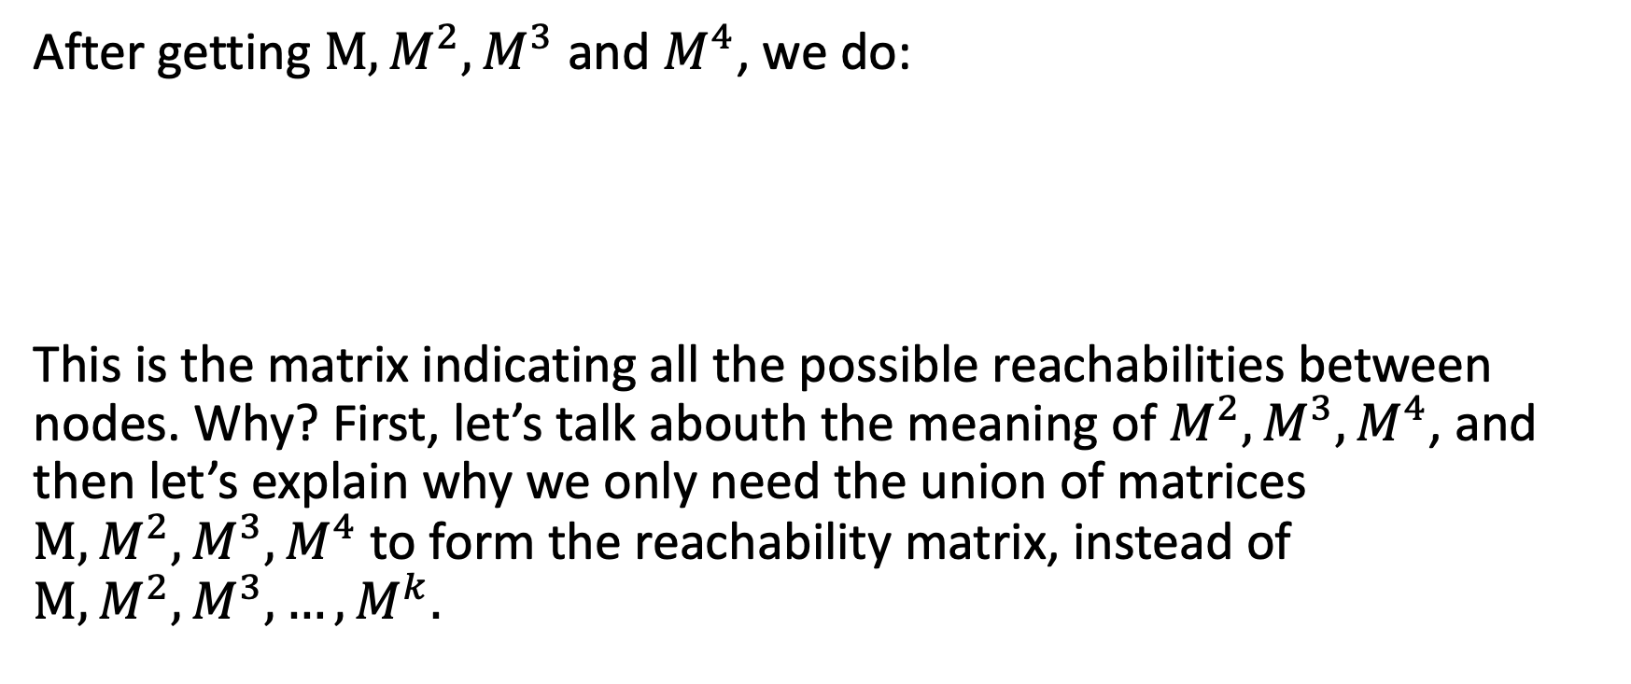
Boolean Adjacency Matrix
After getting $M, M^{2}, M^{3}$ and $M^{4}$, we do:
This is the matrix indicating all the possible reachabilities between nodes. Why? First, let’s talk abouth the meaning of $M^{2}, M^{3}, M^{4}$, and then let’s explain why we only need the union of matrices $M, M^{2}, M^{3},M^{4}$ to form the reachability matrix, instead of $M, M^{2}, M^{3}, …, M^{k}.$

Slide 9
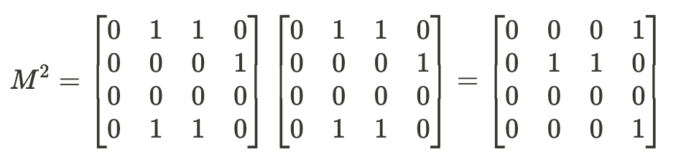
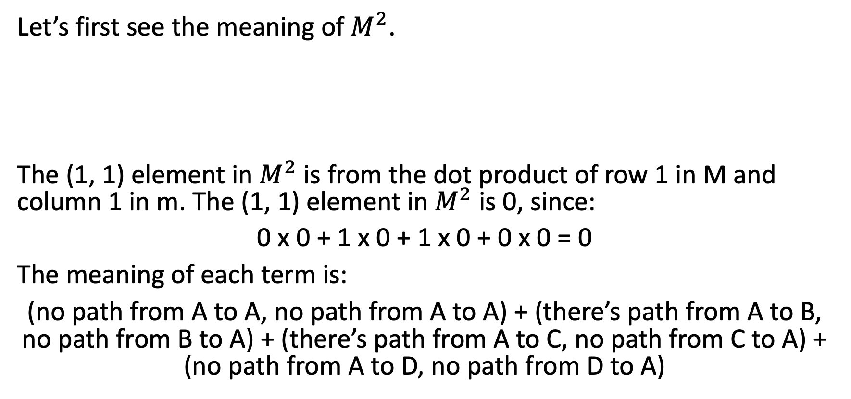
Boolean Adjacency Matrix
Let’s first see the meaning of $M^{2}$.
The (1, 1) element in $M^{2}$ is from the dot product of row 1 in M and column 1 in m. The (1, 1) element in $M^{2}$ is 0, since:
0 x 0 + 1 x 0 + 1 x 0 + 0 x 0 = 0
The meaning of each term is:
(no path from A to A, no path from A to A) + (there’s path from A to B, no path from B to A) + (there’s path from A to C, no path from C to A) + (no path from A to D, no path from D to A)

Slide 10
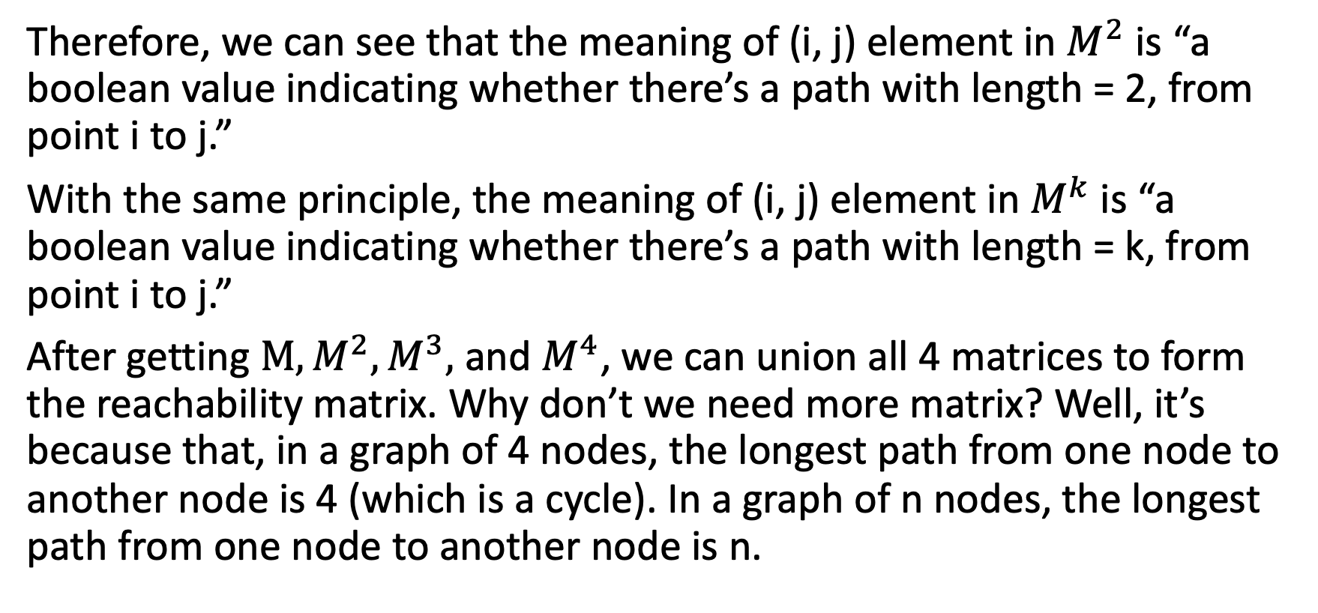
Boolean Adjacency Matrix
Therefore, we can see that the meaning of (i, j) element in $M^{2}$ is “a boolean value indicating whether there’s a path with length = 2, from point i to j.”
With the same principle, the meaning of (i, j) element in $M^{k}$ is “a boolean value indicating whether there’s a path with length = k, from point i to j.”
After getting $M, M^{2}, M^{3},$ and $M^{4}$, we can union all 4 matrices to form the reachability matrix. Why don’t we need more matrix? Well, it’s because that, in a graph of 4 nodes, the longest path from one node to another node is 4 (which is a cycle). In a graph of n nodes, the longest path from one node to another node is n.

Slide 11
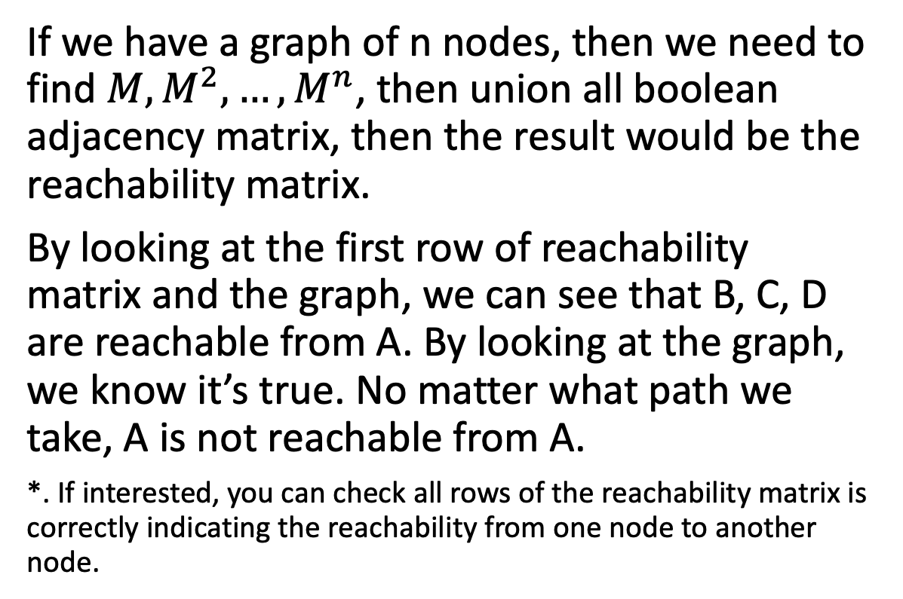
Boolean Adjacency Matrix
If we have a graph of n nodes, then we need to find $M, M^{2}, …, M^{n}$, then union all boolean adjacency matrix, then the result would be the reachability matrix.
By looking at the first row of reachability matrix and the graph, we can see that B, C, D are reachable from A. By looking at the graph, we know it’s true. No matter what path we take, A is not reachable from A.
*. If interested, you can check all rows of the reachability matrix is correctly indicating the reachability from one node to another node.

Slide 12
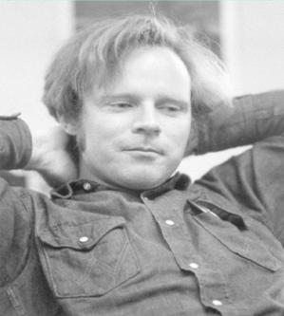
Floyd-Warshall Algorithm
Floyd-Warshall is an algorithm designed to find the pair-wise shortest path in a directed graph. This algorithm was published by Robert Floyd in 1962, a physics major student in University of Chicago.
Even though the same algorithm was designed and published before, by Bernard Roy in 1959 and also by Stephen Warshall in 1962, the algorithm is named after Robert Floyd and Stephen Warshall.

Slide 13
Floyd-Warshall Algorithm
Let n be the number of nodes in the graph, and ceate an n x n matrix.
We assume that the pair-wise distance of all nodes in the directed weighted graph is infinity.
Set the length from node i to itself as 0.
Fill the edges length into the matrix.
we do:
for k in 1 to n: for i in 1 to n: for j in 1 to n: if distance[i][j] > distance[i][k] + distance[k][j] distance[i][j] = distance[i][k] + distance[k][j]

Slide 14
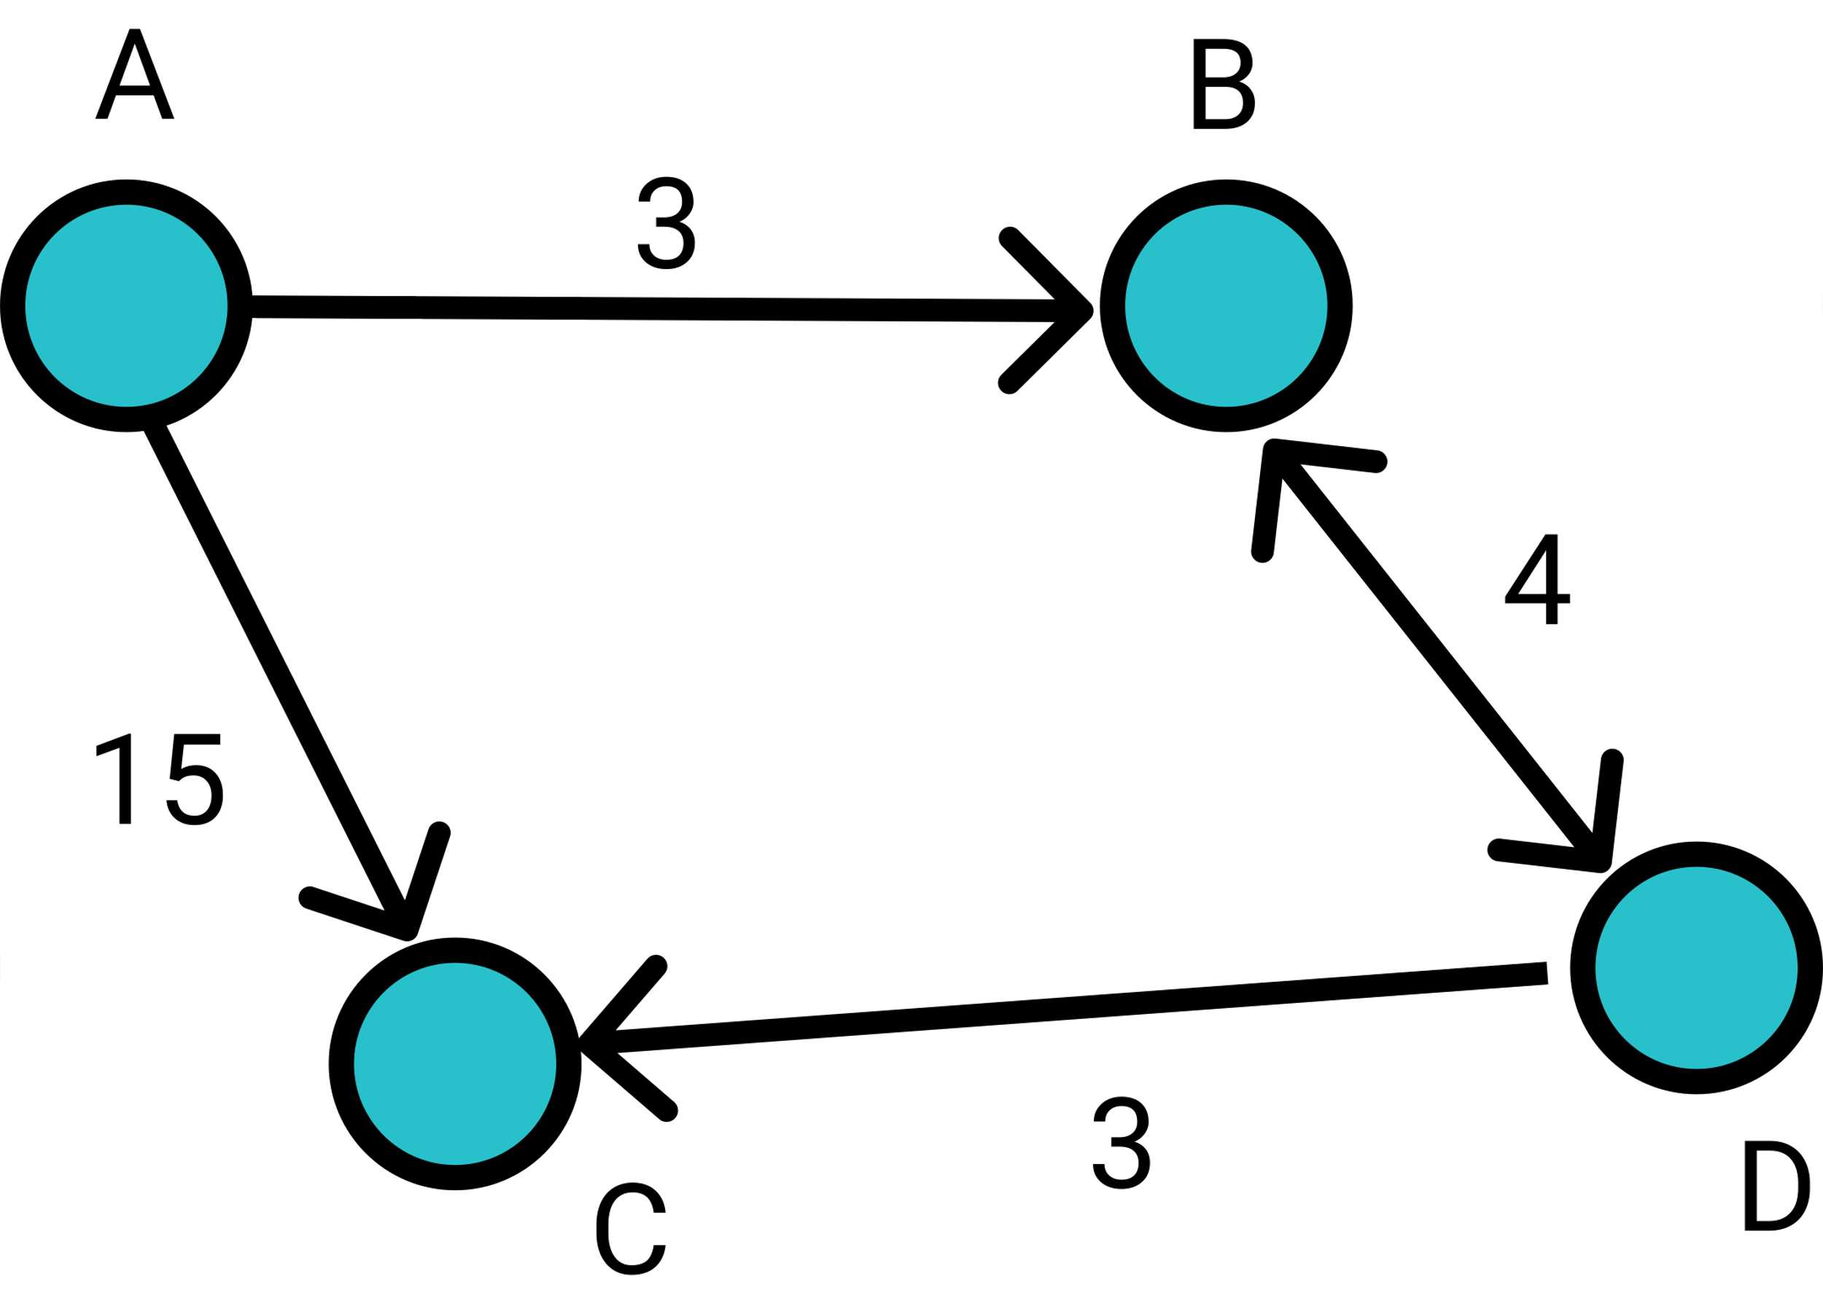
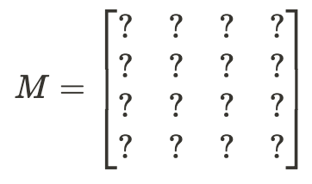
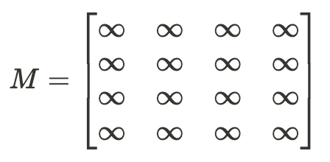
Floyd-Warshall Algorithm
The meaning of Floyd-Warshall Algorithm is to check that, from node i to node j, if going through node k would make the path shorter.
The first step of Floyd-Warshall is to make a 4 x 4 matrix:
Then, we assume the pair-wise distance is infinity.

Slide 15
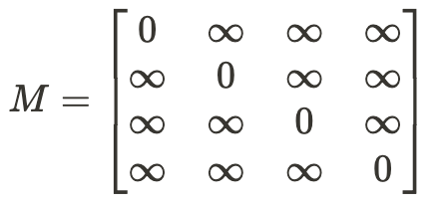
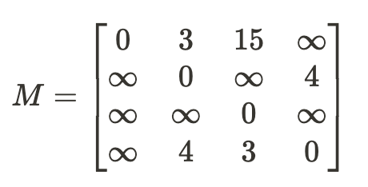
Floyd-Warshall Algorithm
Then, we set the value on the main diagonal to be 0:
Then, we put values of edges on the matrix:

Slide 16
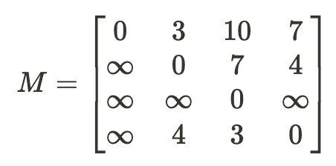
Floyd-Warshall Algorithm
Then, we do:
for k in 1 to n: for i in 1 to n: for j in 1 to n: if distance[i][j] > distance[i][k] + distance[k][j] distance[i][j] = distance[i][k] + distance[k][j]
Then, we would get:

Slide 17

7-2 Euler Path and Hamilton Circuit

Slide 18
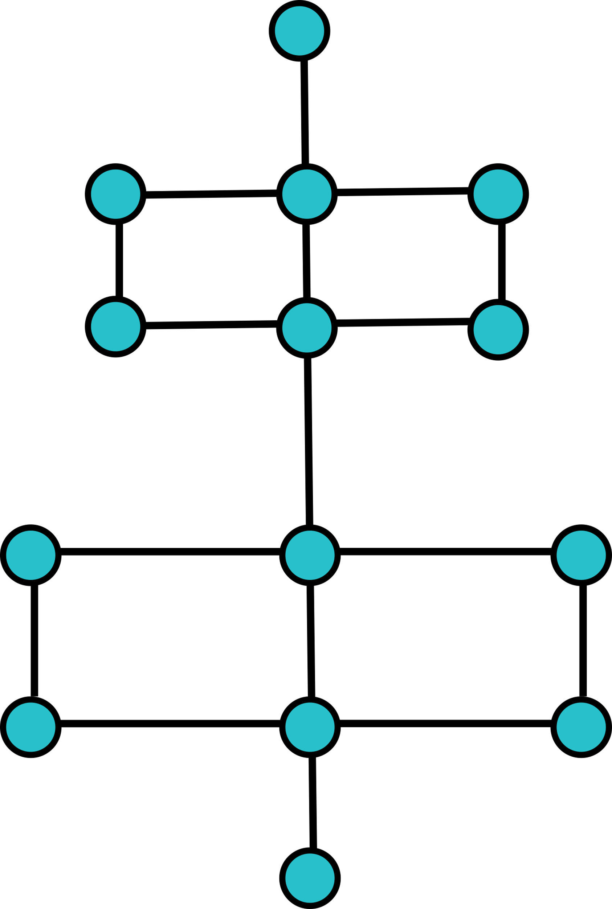
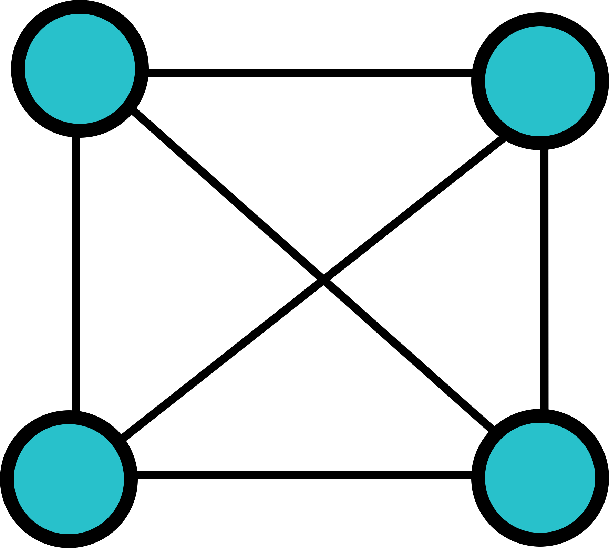
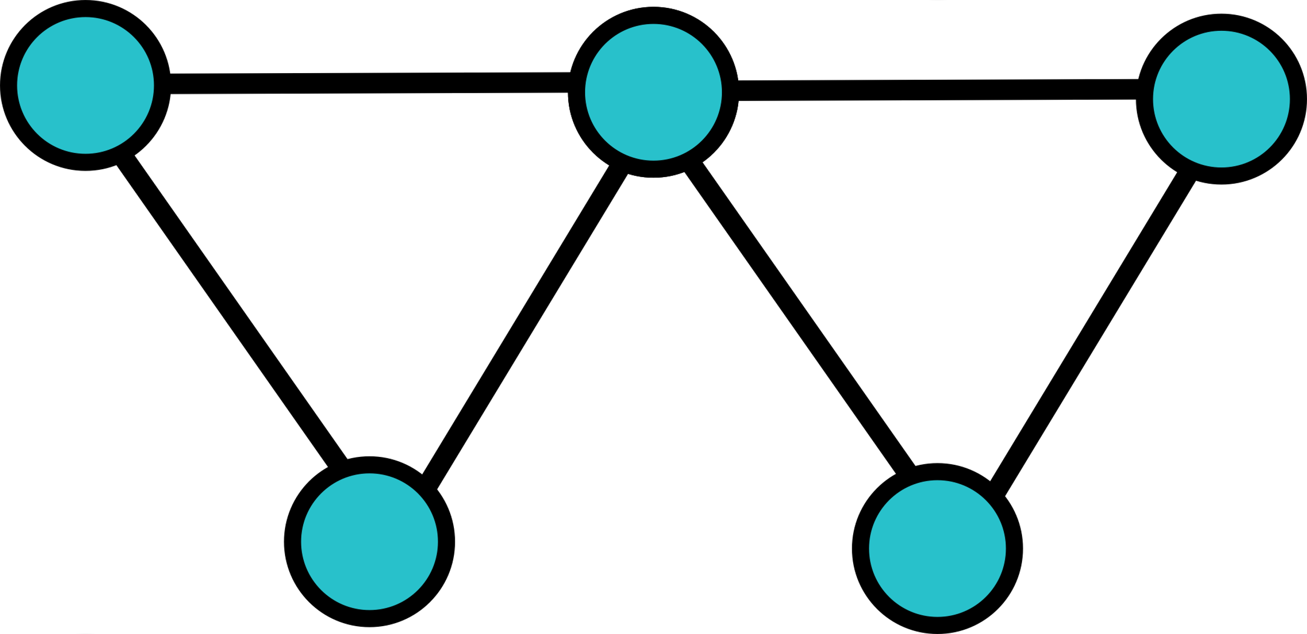
Euler Path
In graph theory, a Euler trail (or Eulerian path) is a trail in a finite graph that visits every edge exactly once (allowing for revisiting vertices). Given a random finite graph, how do we know if the Euler path exists or not? For example, only the first and third graph has Euler path. No matter how hard we try, we would never find a Euler path in the for the middle graph.

Slide 19
Euler Path
Let’s learn the term “degree”. The degree of a node is the number of edges connecting to the node. An odd node means the degree of the node is odd.
A graph has a Euler path if:
The graph has no odd nodes. The path can begin at anywhere and end at anywhere.
The graph has 2 odd nodes. The path must begin at one of the odd node, and end at the other odd node.

Slide 20
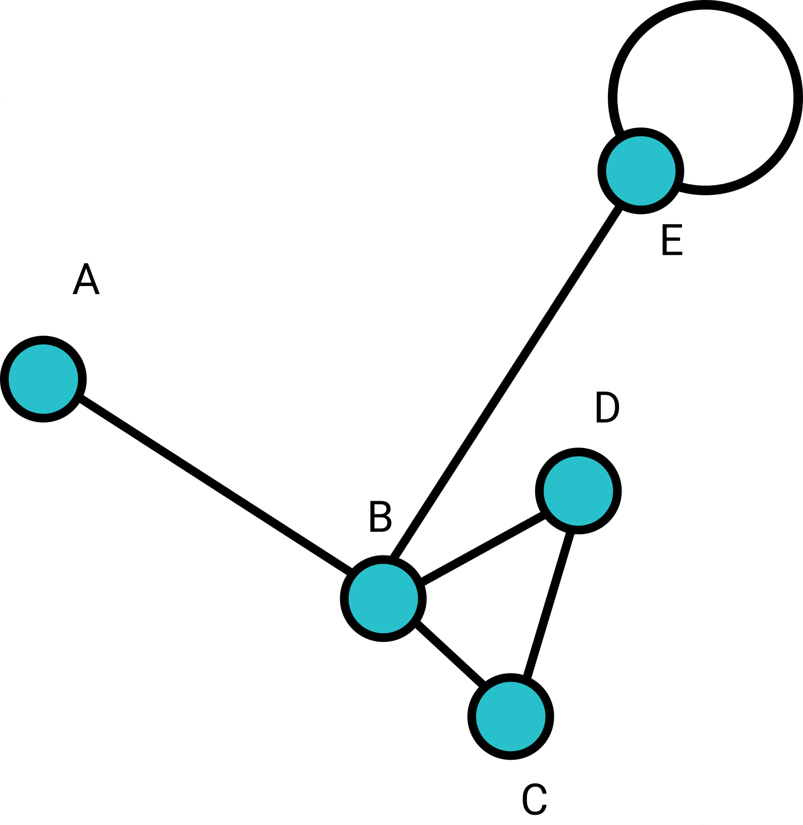
Euler Path
Let’s consider the case of 2 odd nodes. When finding an Euler path of a graph, if the node is not the beginning or end point, then if we enter the node, then we must exit from the node.
For example, if we draw an Euler path from A, then we will enter B; then we would exit from B and enter node C; then we would exit from C and enter node D; then we would exit from D and enter B again; then we would enter E, and exit E; then we would enter E and stop.

Slide 21
Euler Path
Now, we can see that only A and E can be odd nodes. For any other nodes, if we visit it, then we must exit the node; that makes any other nodes “even”.
For A and E, they can be odd, since we start and stop Euler Path there.
If we look back to the graph 串, then we can see that there’s only 2 odd nodes, and the rest of nodes are all even; that guarantees the existence of Euler Path.

Slide 22
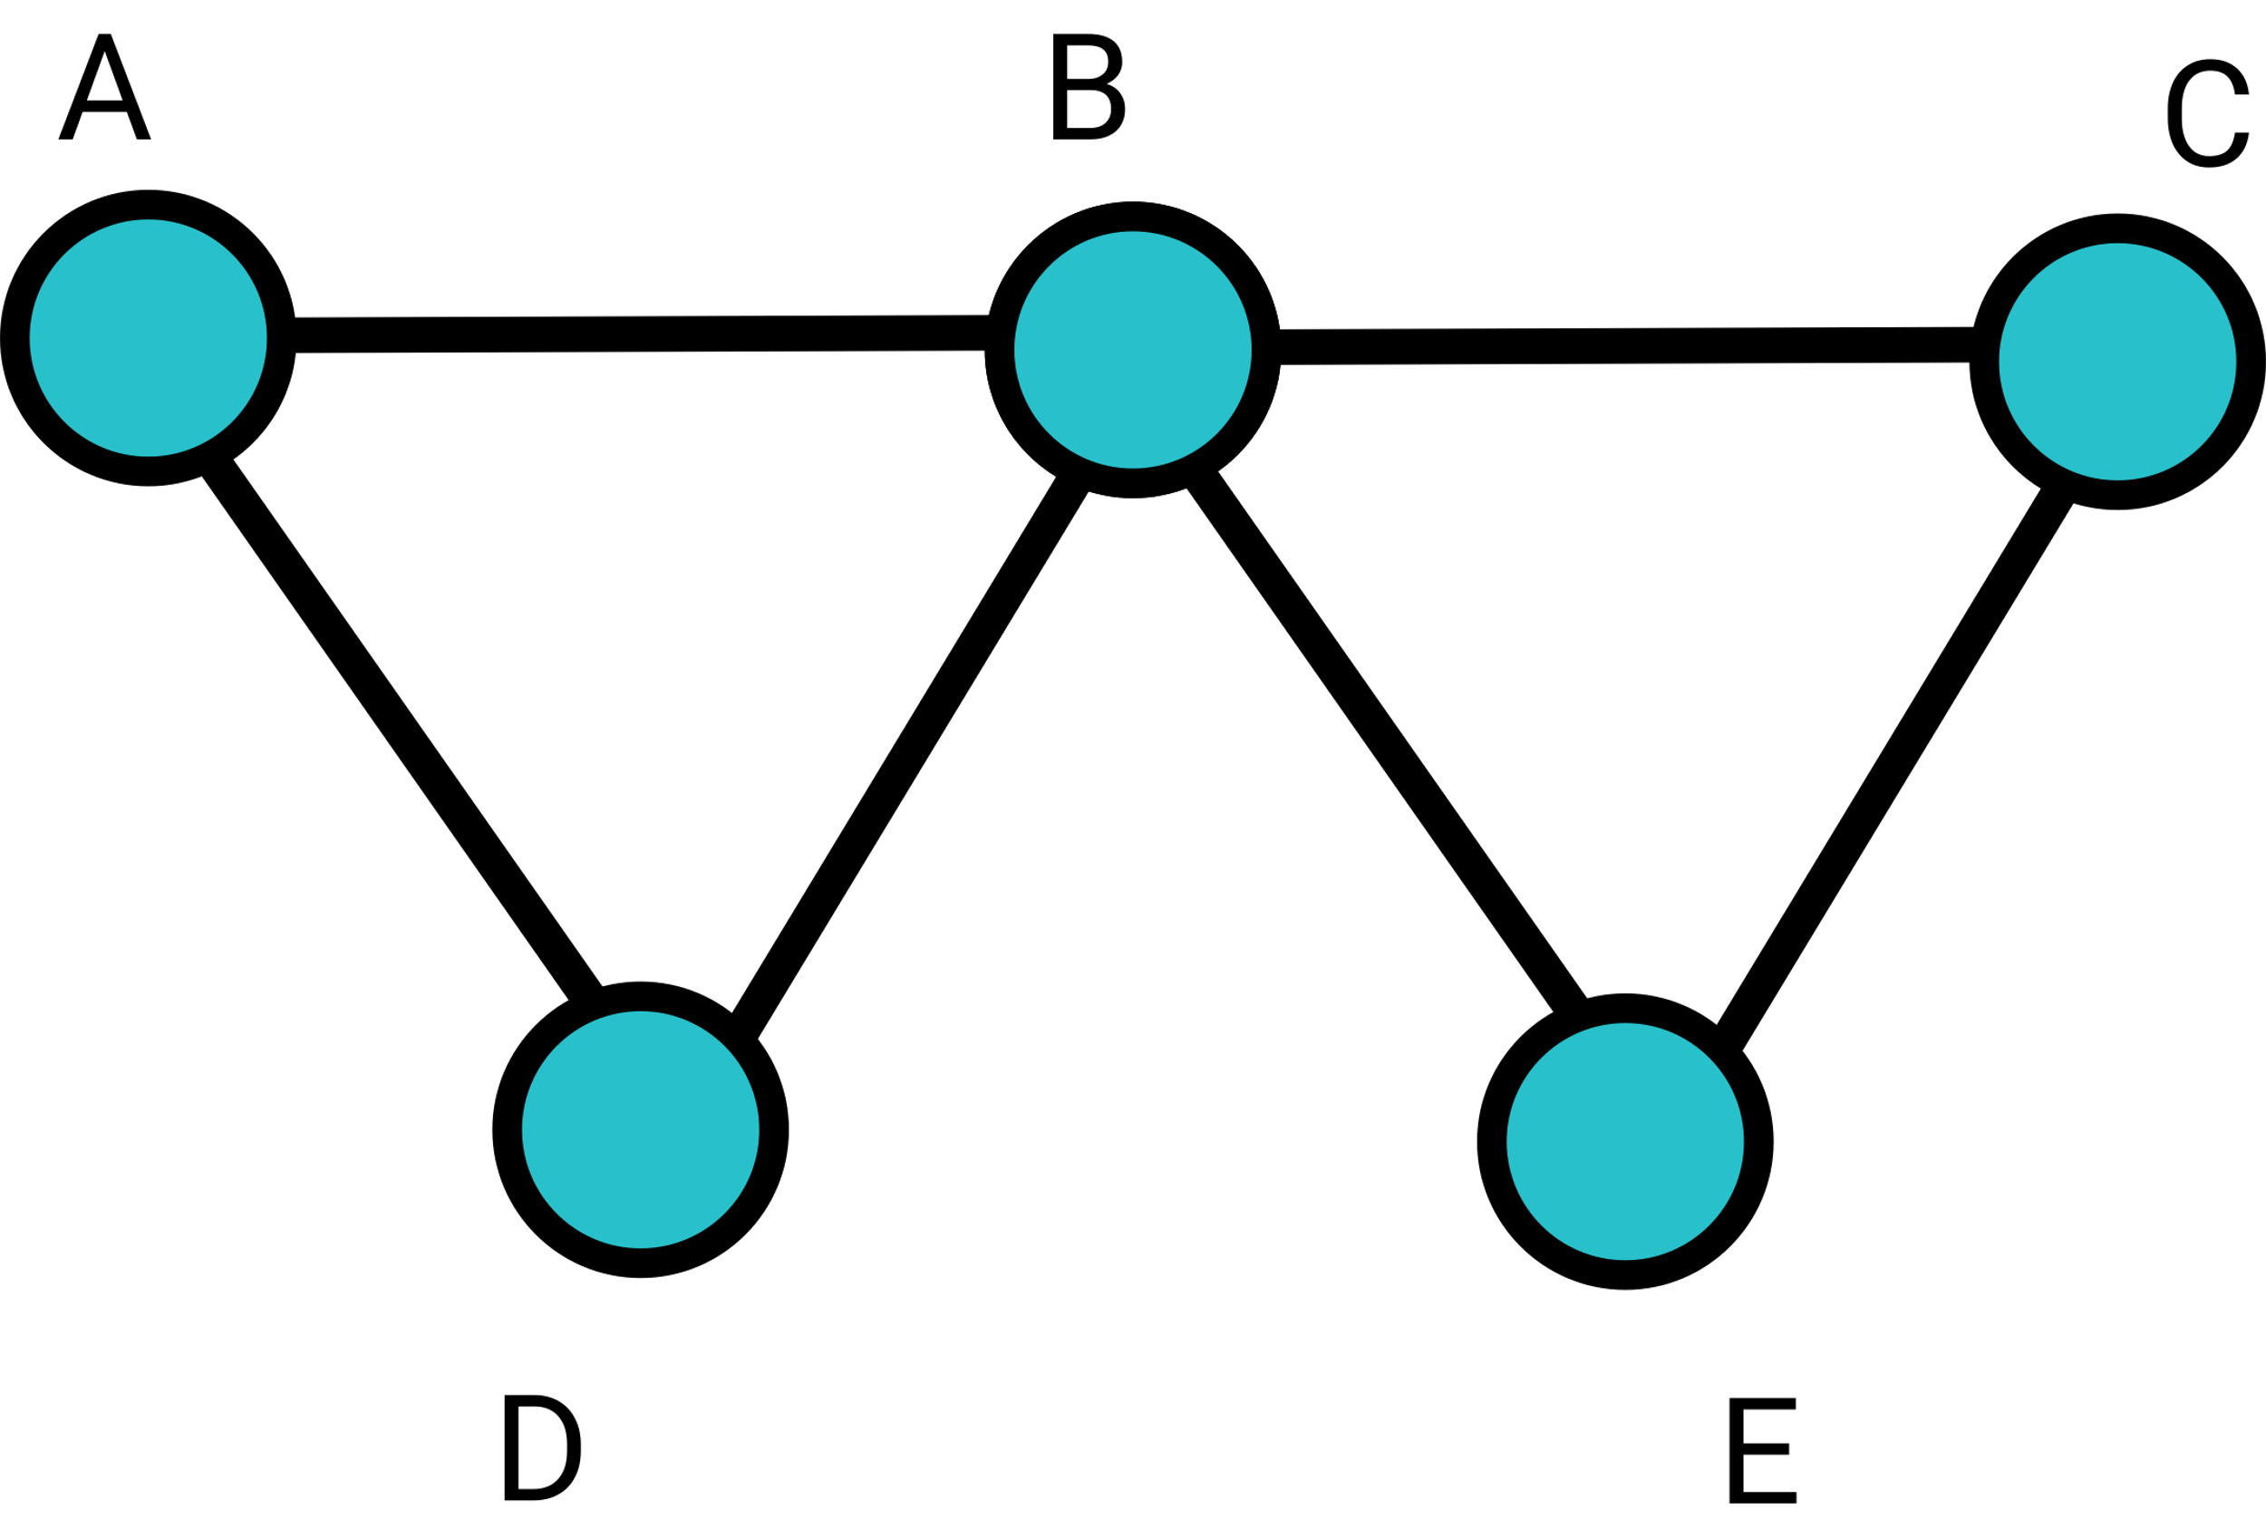
Euler Path
Let’s consider the case of no odd nodes. Since all nodes are even, we can start the Euler Path from any node; supposed we start from B, then we enter C, then exit from C and enter E; then exit from E, and enter B again; then exit from B, and enter D; then exit from D, and enter A; then exit from A, and enter B again, and stop.
If all nodes are even, that means that, for each node, we would exit and enter again; that guarantees the existence of Euler Path.

Slide 23
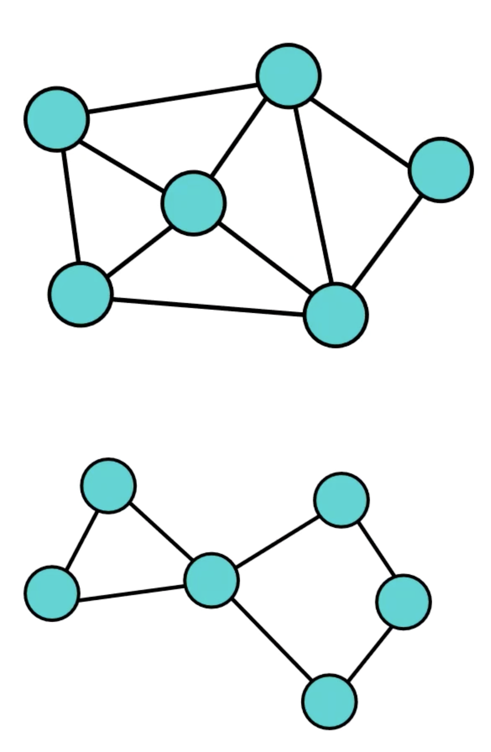
Hamilton Cycle
Hamilton Cycle is another problem in graph theory that is similar to Euler Path. Hamilton cycle is a path that visits all the vertex exactly once.
The top graph as Hamilton cycles, but the bottom graph does not.
There’s no efficient algorithm (yet) in the world to find a Hamilton Cycle in a graph. Acutally, it’s even unknown if such algorithm exists in the world. This problem (to prove if such algorithm exists) is called a P vs NP problem, which will be taught in algorithm and data structure.

Slide 24

7-3 Shortest Path Problem

Slide 25
Shortest Path Problem
Supposed we have a connected weighted graph, then there might be several possible path to go from node i to node j. How do we find the shortest path between one node to another node? Well, Floyd-Warshall algorithm might be an option, but it’s too computational heavy to run this algorithm. (As the size of graph grows, the algorithm run time would explosively grow.)
In 7-3, we will learn a better algorithm called “Dijkstra’s Algorithm”, which is much less computational heavy. The downside of Dijkstra’s algorithm is - we cannot get the pair-wise shortest path of all nodes; instead, we have to pick one node, and run the algorithm, then the algorithm will return the shortest path from the picked node to any other nodes.

Slide 26

Dijkstra’s Algorithm
This algorithm is conceived by computer scientist Edsger W. Dijkstra in 1956 and published 3 years later. The application of Dijkstra’s algorithm is HUGE, such as the least-cost path of builing electricity lines or oil pipelines, network routing, footpath optimization problems, and many others.
Since the actually coding task for Dijkstra’s Algorithm requires some data structure, we will only learn the concept here.

Slide 27
Dijkstra’s Algorithm
Label all nodes on the graph to be infinity.
Set the starting node to be 0, and mark it as visited.
Label starting node’s neighbors the length of the edge.
For all nodes in the graph, take the unvisited node with the minimal labeled value; then, mark the node as visited, and check the node’s neighbors. For each neighbor, if the the node value + node’s edge to the neighbor < neighbor’s value, then update the neighbor's value.
Keep repeating step 4 until all nodes are visited.

Slide 28
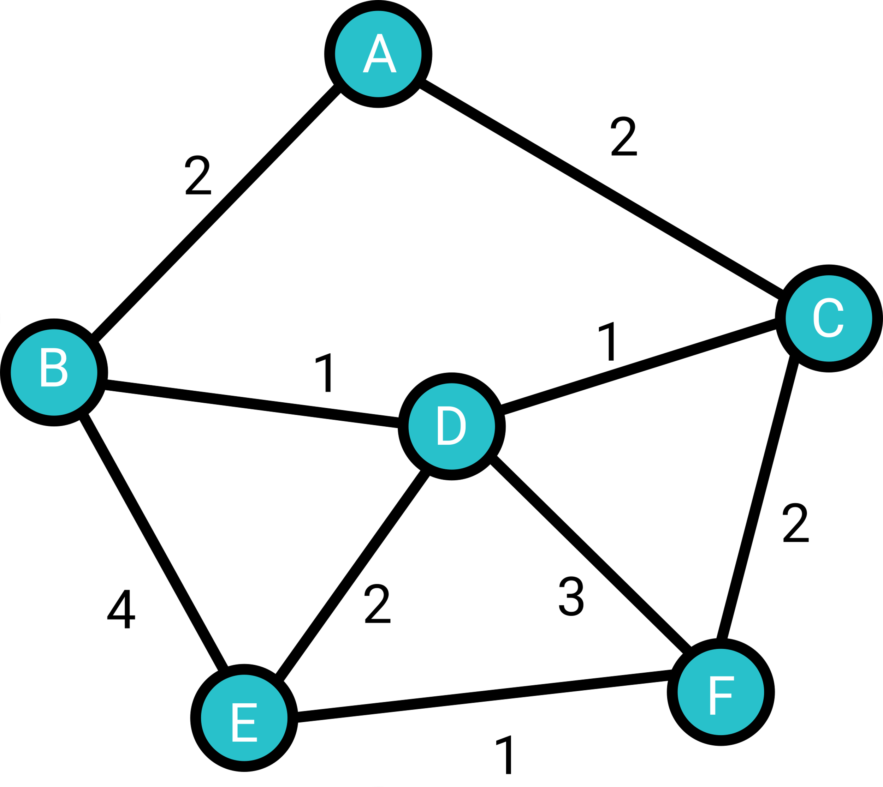
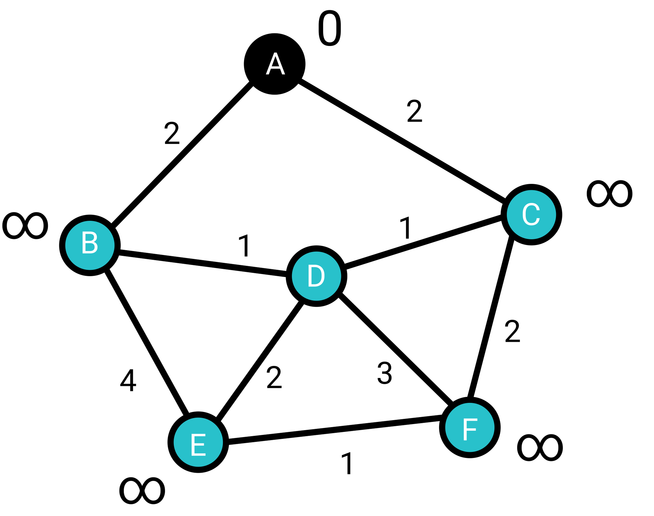

Dijkstra’s Algorithm
For example, we pick A as the starting point. Then, we set a value of infinity for each node, and set A’s value to be 0, then mark A as visited. We would get:
Then, we set B and C’s value to be 2 and 2.

Slide 29
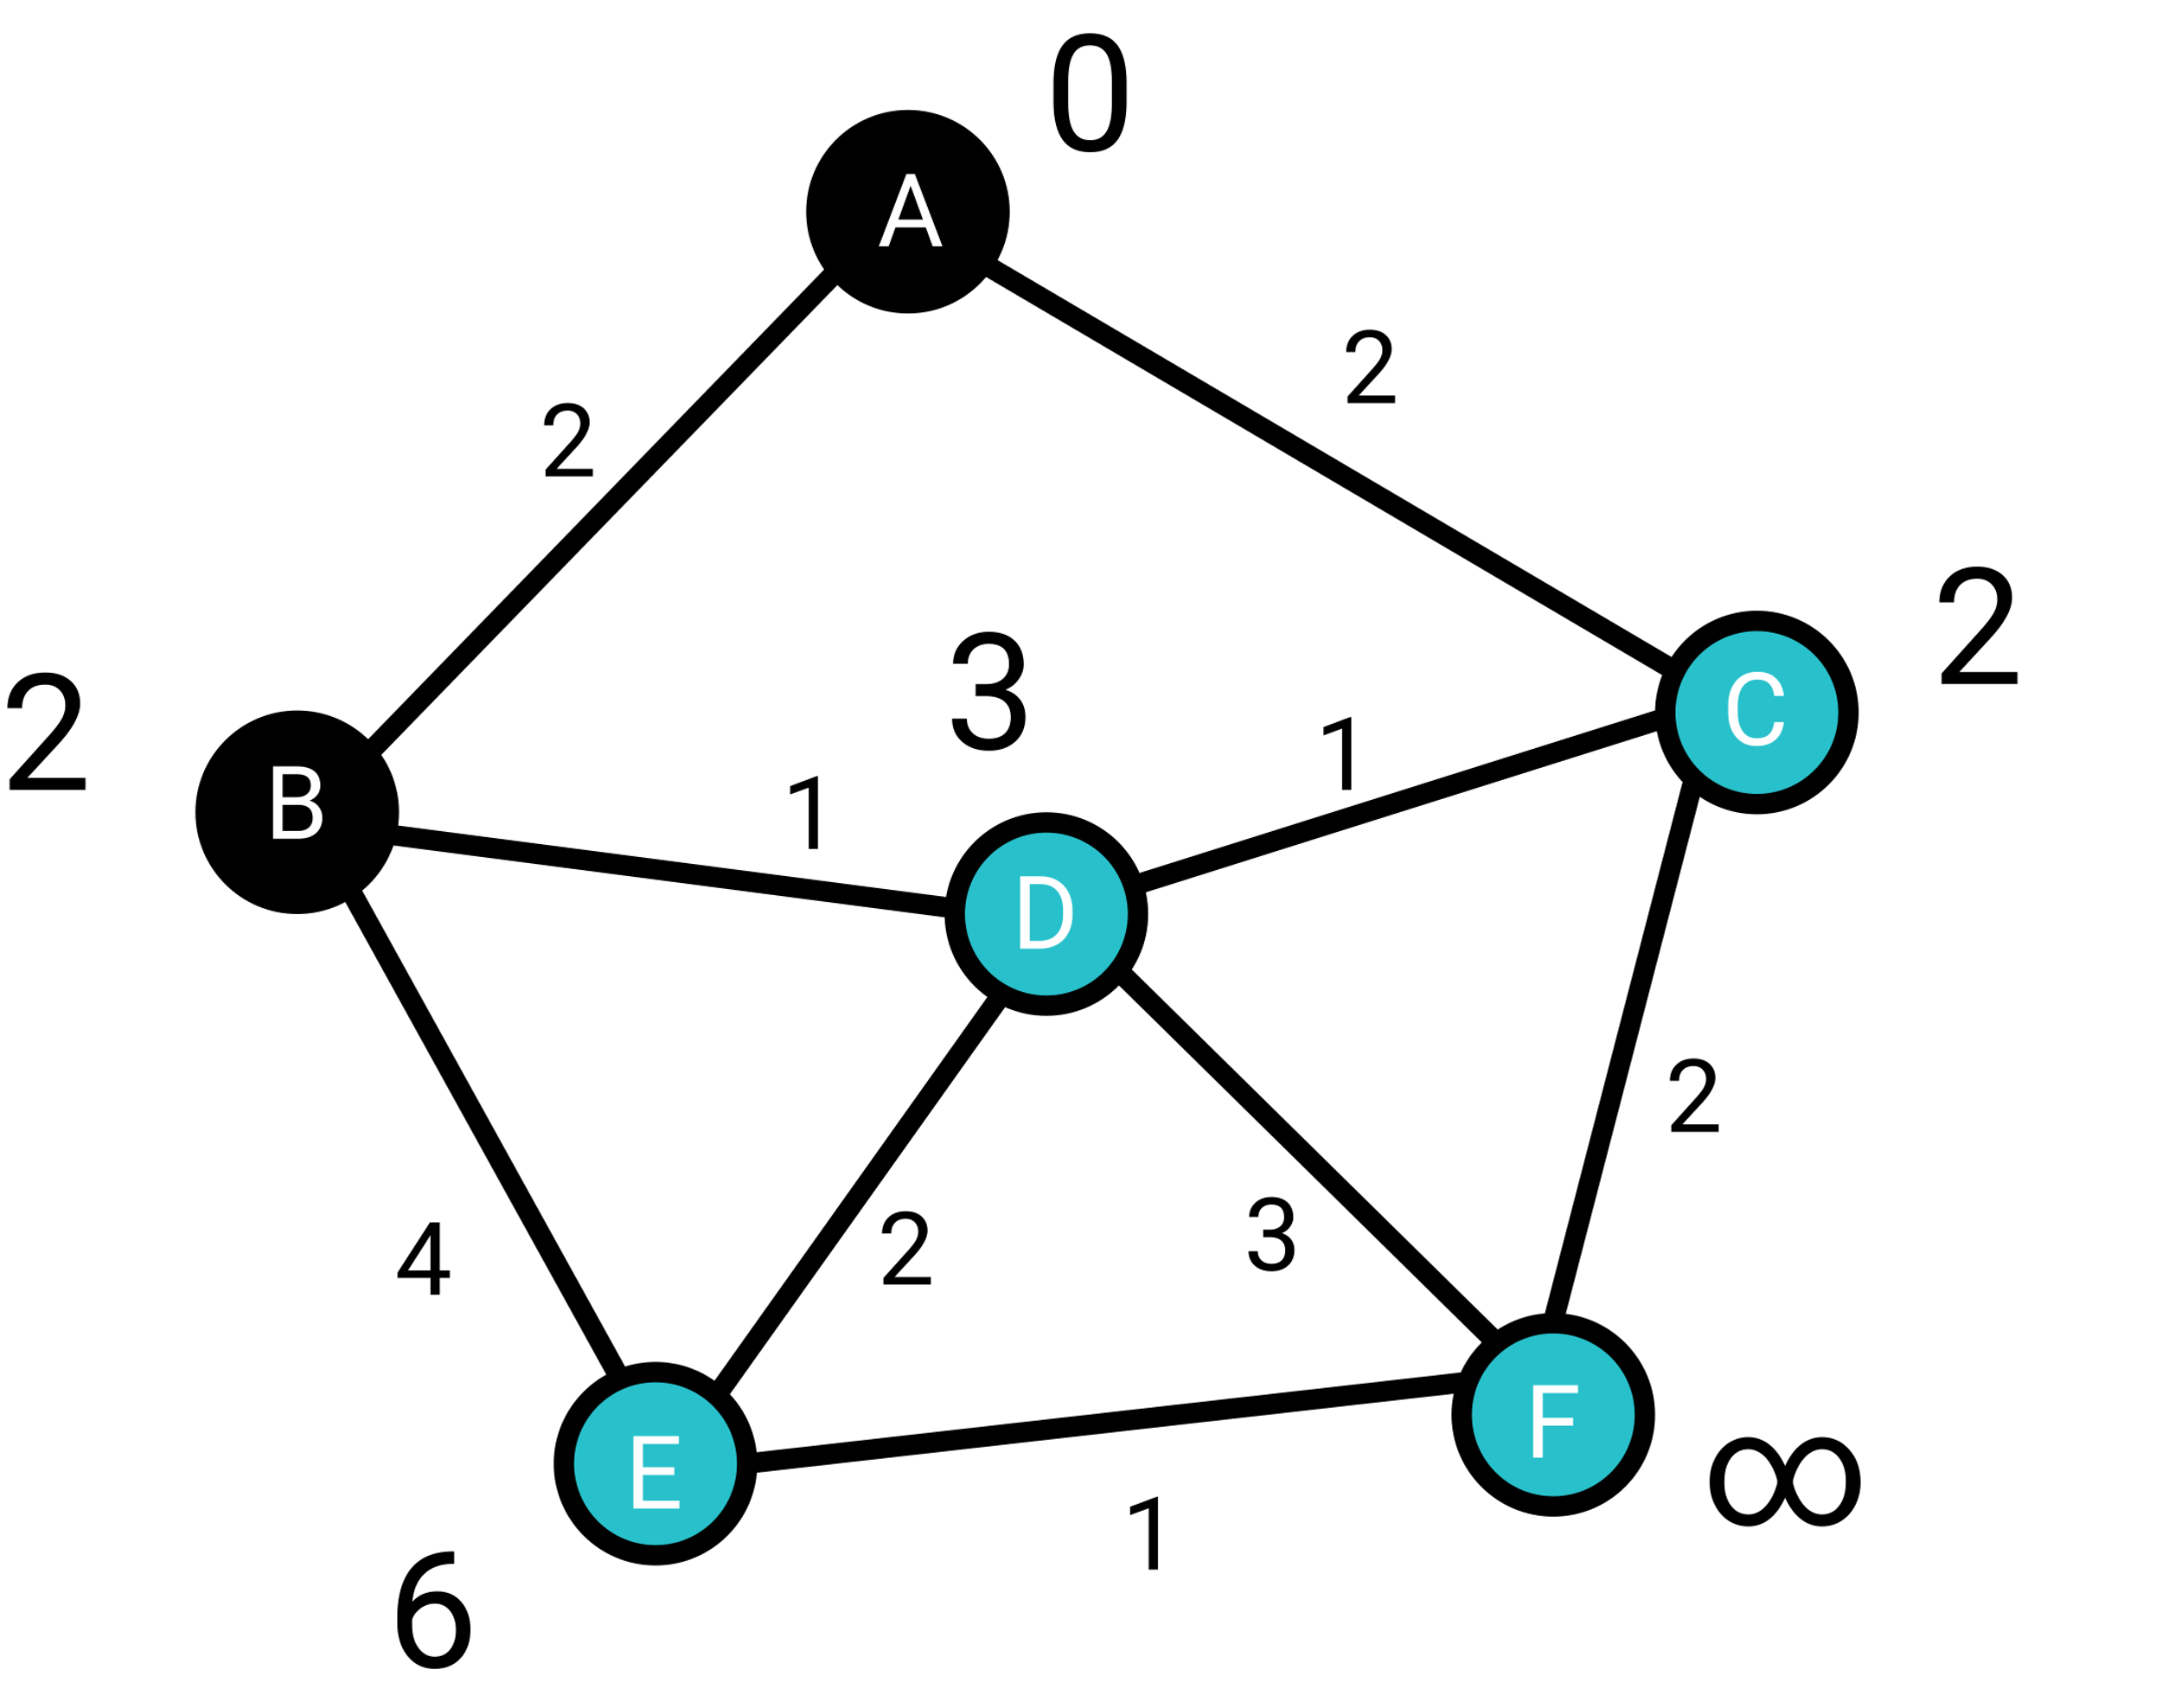
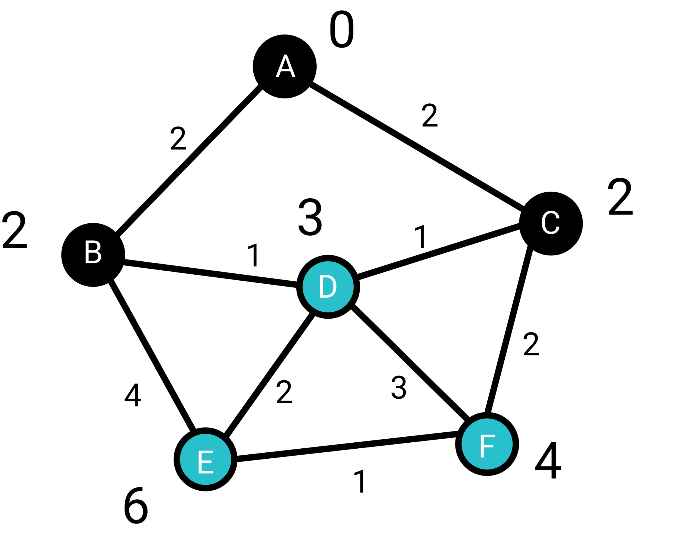
Dijkstra’s Algorithm
For all the unvisited nodes, B and C have the minimum value; here we would pick B. Mark B as visited, and update the value of B’s neighbors. Then, we get the new graph on the right.
Then, for all the unvisited nodes, C has the minimum value; mark C as visited ,and update the value of C’s neighbors.

Slide 30
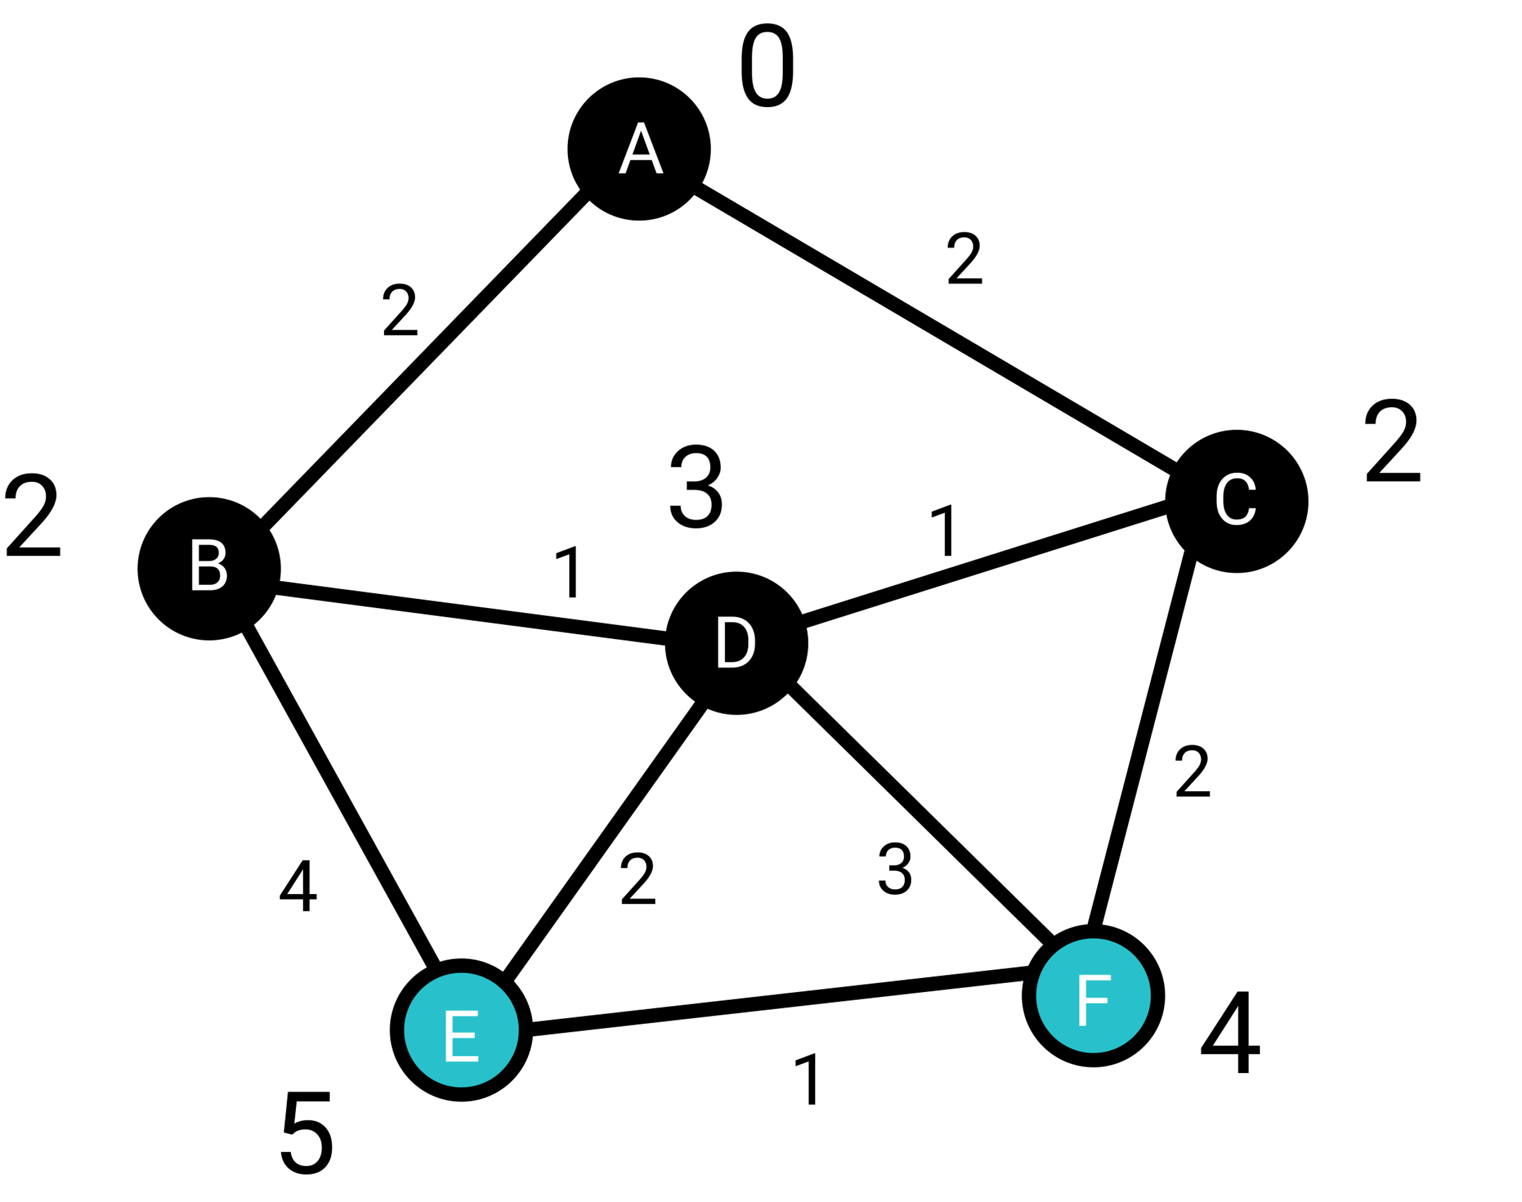
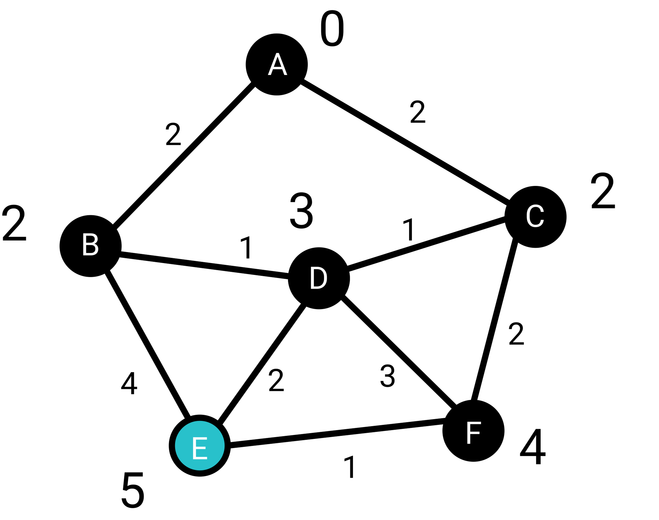
Dijkstra’s Algorithm
Then, for all the unvisited nodes, D has the minimum value; mark D as visited ,and update the value of D’s neighbors. Then, we get the new graph on the right.
Then, for all the unvisited nodes, F has the minimun value; mark F as visited ,and update the value of F’s neighbors.
Then, E is the last unvisited node; done with Dijkstra’s algorithm.

Slide 31
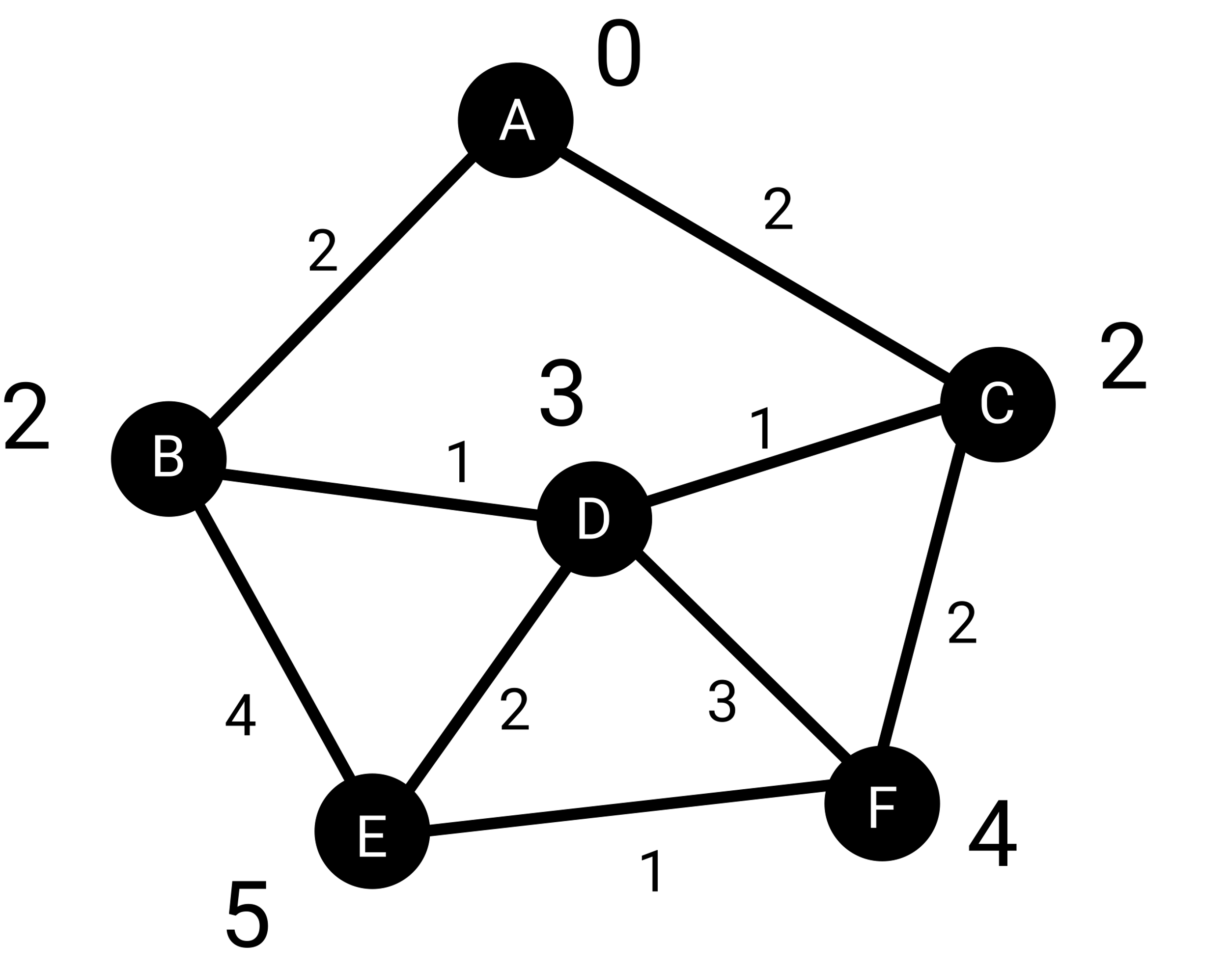
Dijkstra’s Algorithm
After running Dijkstra’s algorithm on node A, we get the shortest distance from A to all nodes.
Here’s the table of shortest distance from A:
Node | Shortest Distance from A
A | 0
B | 2
C | 2
D | 3
E | 5
F | 4

Slide 32

7-4 Graph Traversal

Slide 33
Graph Traversal
In tree traversal, we learned about depth first and breadth first traversal. The same concept applies to graph traversal; with depth first graph traversal, we go as deep as we can; if we come across a dead end, then we traval backwards, and see if we we go deeper from there.
When doing breadth first traversal, we would record all neighbors of the current node; then we would proceed to the next node in the record, then record all unvisited neighbors of the current node; keep doing this until we finish traveling through the graph.

Slide 34
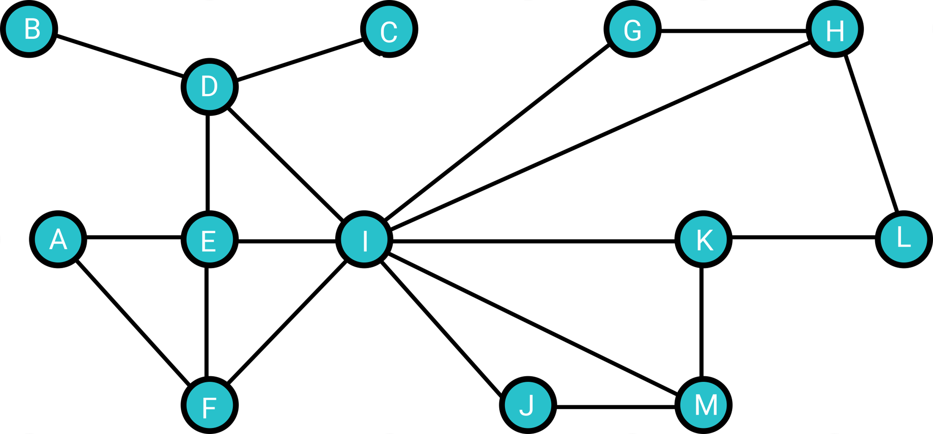
Graph Traversal
Supposed we start the traversal algorithm from A, then:
The depth first traversal result of the graph will be:
A, E, D, B, C, I, F, G, H, L, K, M, J
The breadth first traversal result of the graph will be:
A, E, F, D, I, B, C, G, H, J, K, M, L

